Slide 1


Power Management Solutions for Xilinx® FPGAs/SoCs
April 2019

Slide 2

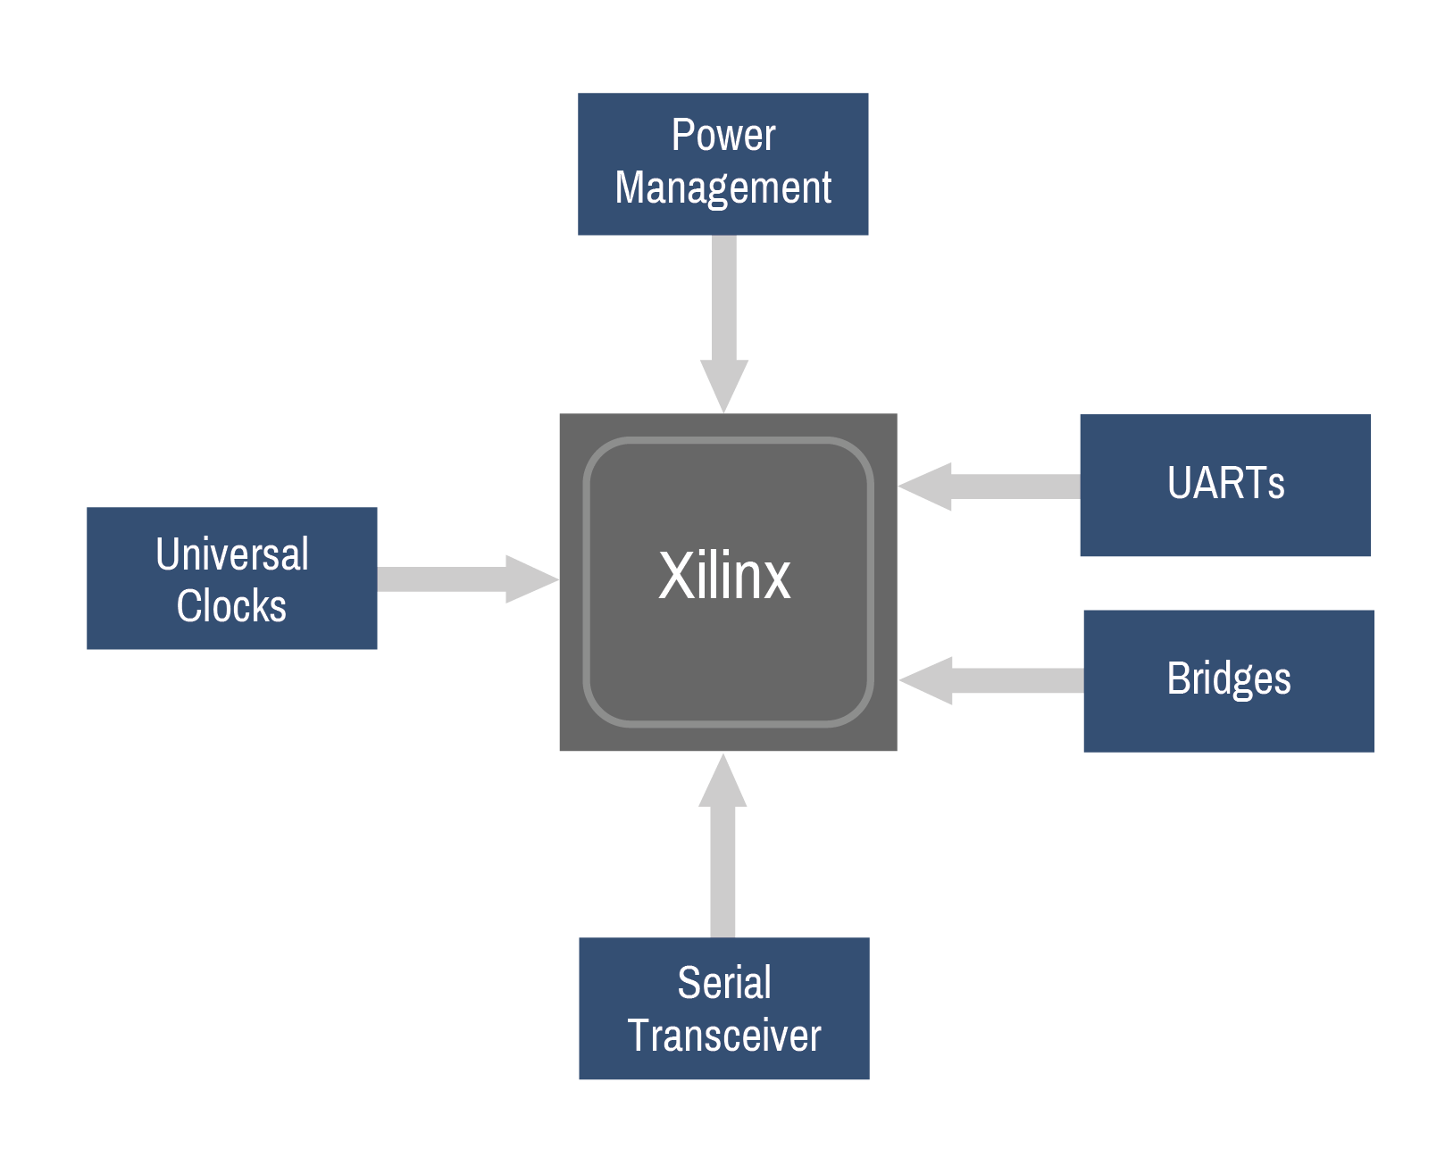
Power Management & Analog Solutions for Xilinx Zynq® and Zynq® UltraScale+™ FPGAs
Xilinx reference designs
  Zynq-7000
  Zynq-7020
  Zynq UltraScale+ MPSoCs
    Zynq UltraScale+
    Zynq UltraScale+ (No MGTs)
  Zynq UltraScale+ ZU2, ZU3

Slide 3
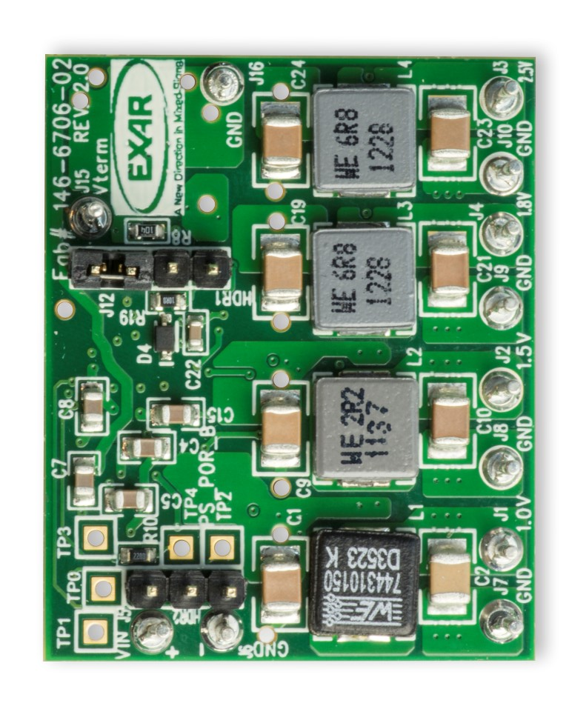
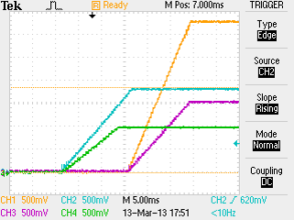
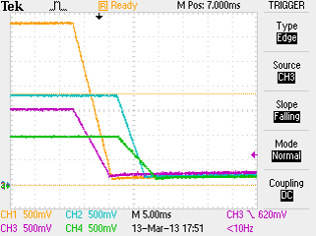
Xilinx Zynq-7000 All Programmable SoC Power System
Powers Zynq 7000 in 1.875 in²
I2C programmable output voltage, Switching Frequency, Sequencing, and Fault Management
Dynamic Voltage Scaling
XRP7714
Reference Design
Xilinx® Zynq®-7000 SoC
2.5V I/O
1.8V VCCAUX, VCCPLL
Order and Ramp rates for each supply meet Zynq-7000 requirements
1.5V DDR3
1.0V VCCINT, VCCBRAM, VCCPINT
0.75V Vterm for DDR3 SDRAM
4 GPIO signals can be programmed to provide status of PGOOD signals, enables and faults or as I/O expansion

Slide 4
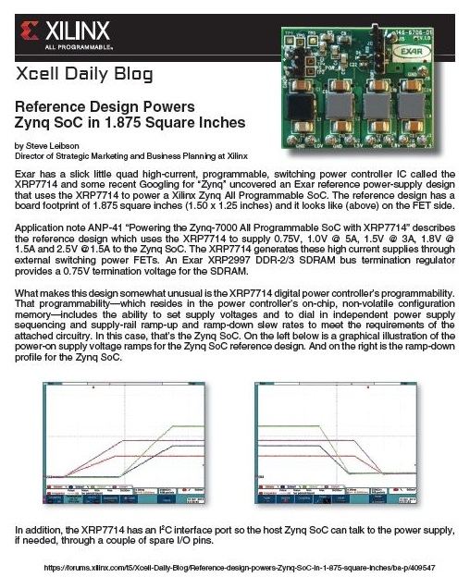
Zynq 7000 Reference Material
Application Note ANP-41
Zynq EVB Configuration File
OrCAD and PADS Design Files
and more…
Visit: www.exar.com/products/zyqn-evb

Slide 5
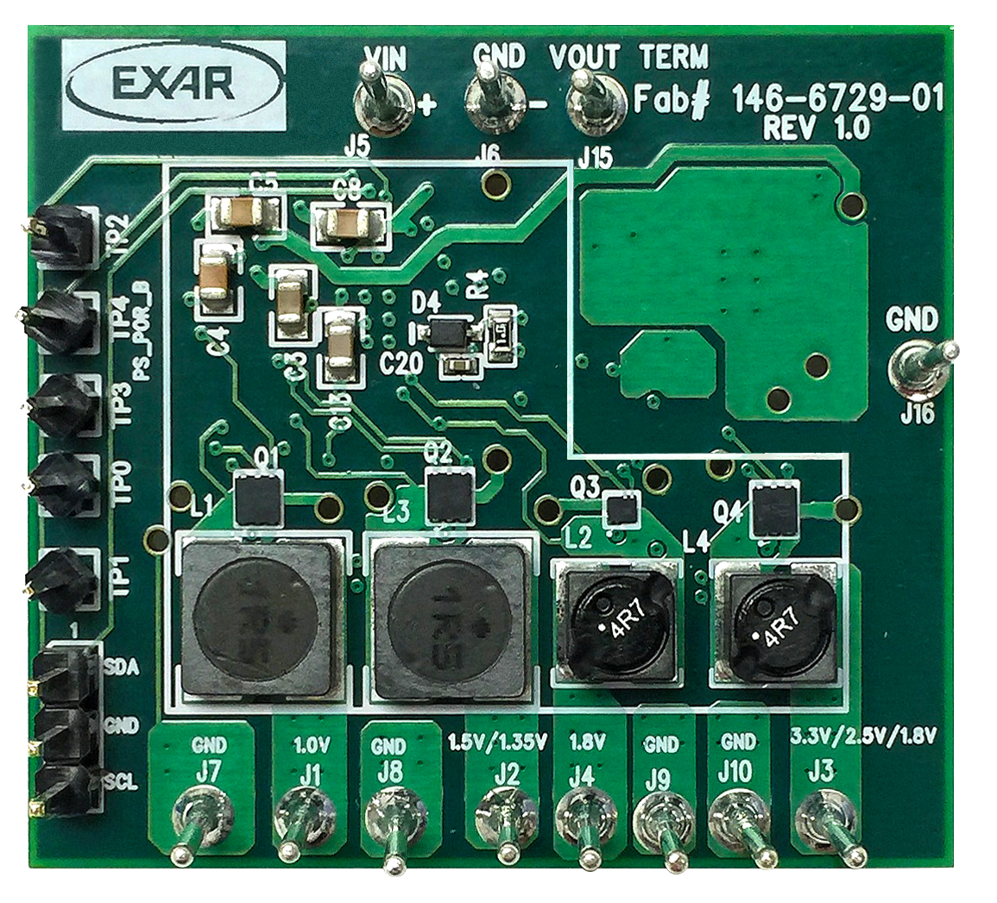
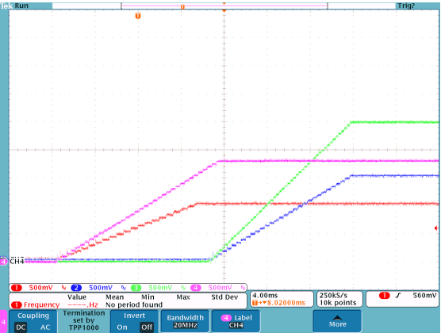
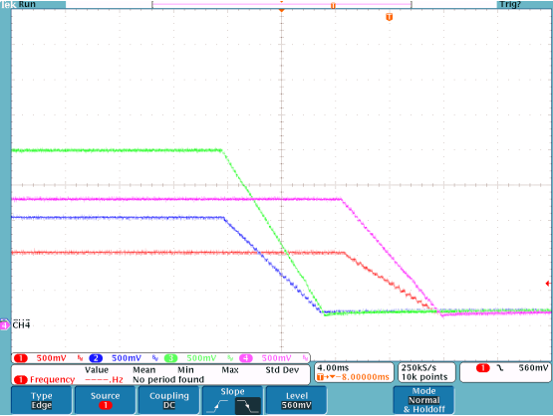
Xilinx Zynq-7020 All Programmable SoC Power System
Industrial Ethernet Power Solution using XRP7714
Powers Zynq 7000 in 1.875 in²
I2C programmable output voltage, Switching Frequency, Sequencing, and Fault Management
Dynamic Voltage Scaling
XRP7714
Reference Design
Xilinx® Zynq®-7020 SoC
1.8V to 3.3V VCCO
1.8V VCCAUX, VCCADC
1.2/1.35/1.5V DDR3
Order and Ramp rates for each supply meet Zynq-7020 requirements
1.0V VCCINT, VCCBRAM, VCCPINT
0.60/0.675/0.75V VTT
3 GPIO signals can be programmed to provide status of PGOOD signals, enables and faults
Visit: www.maxlinear.com/products/zyqn-7020

Slide 6
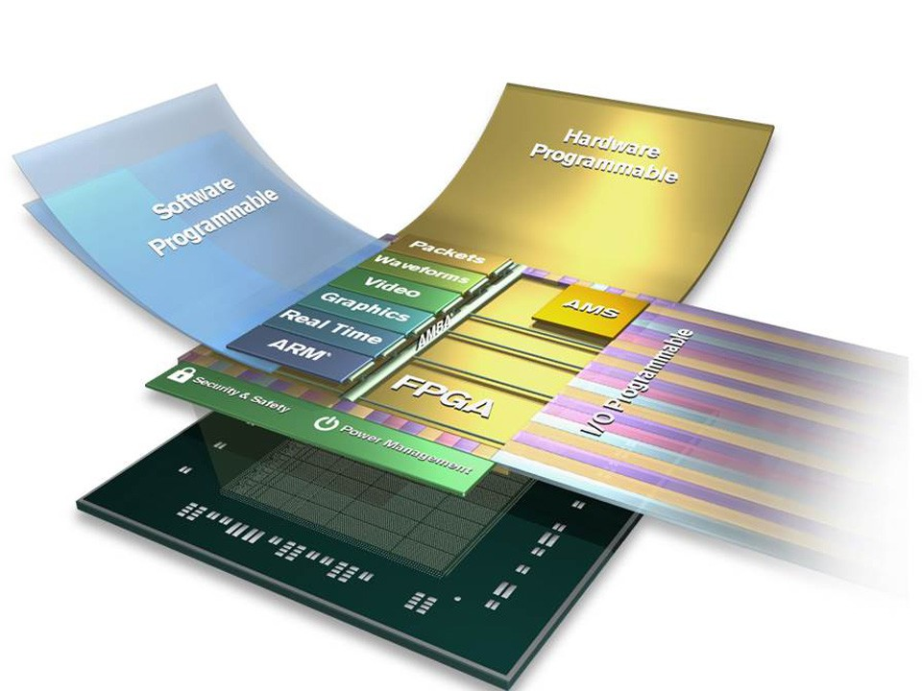
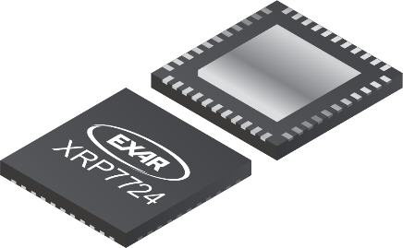
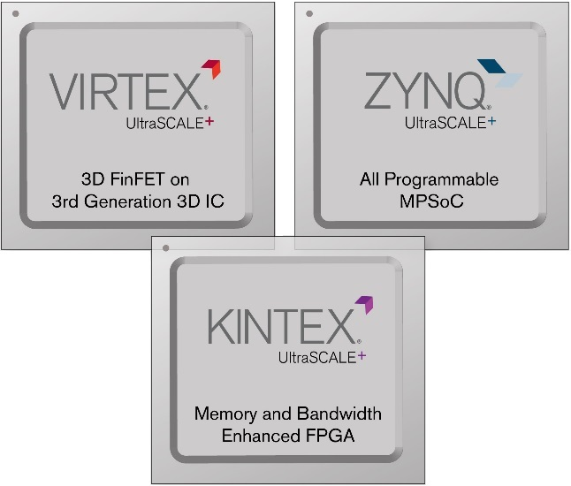
Power Management Solutions for Xilinx UltraScale+
Featuring the XRP7724
Intelligent solution manages design challenges
Easy-to-use
Flexible solution works with whole UltraScale+ family
Simple Programmable Solution

Slide 7
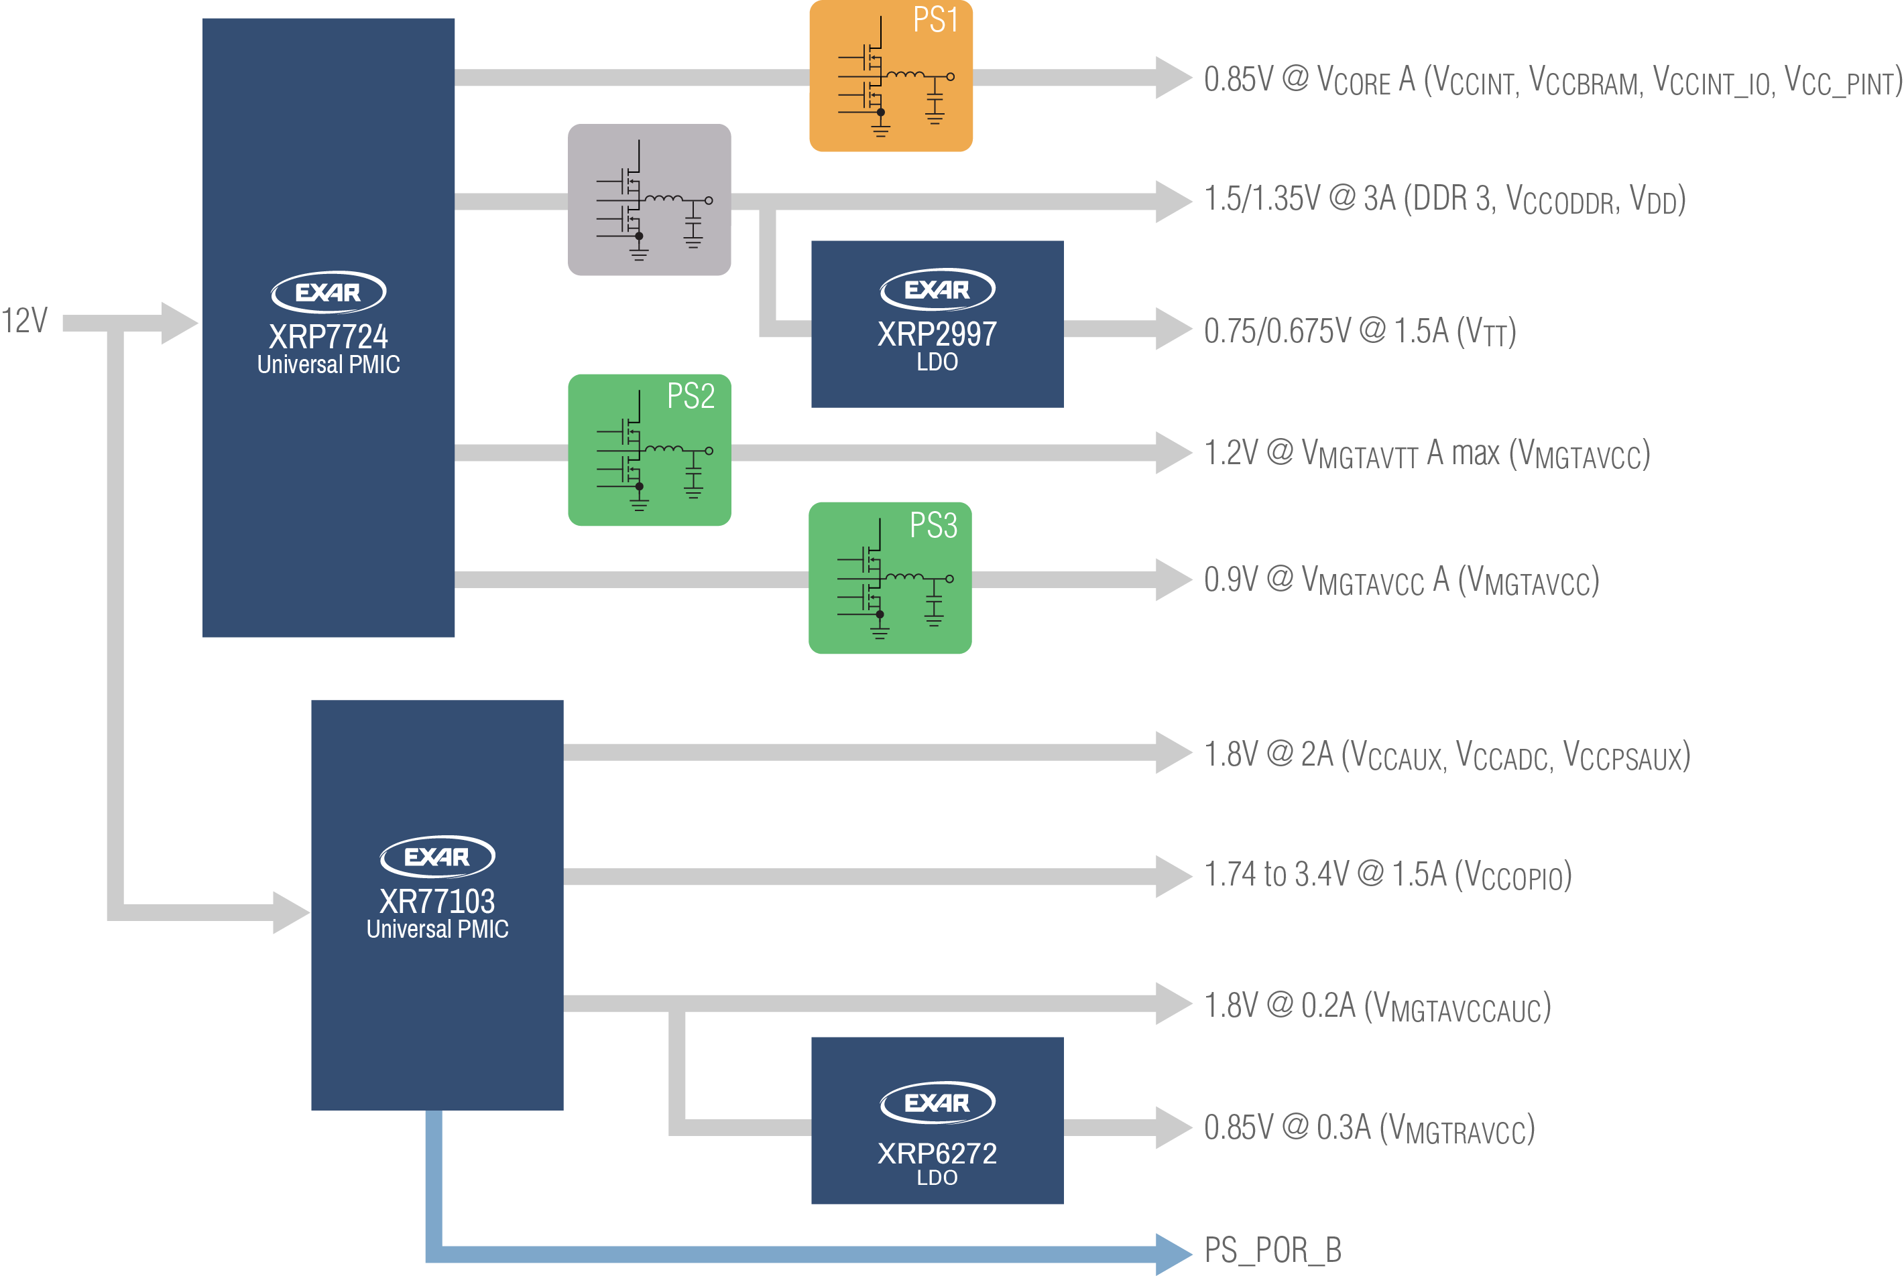
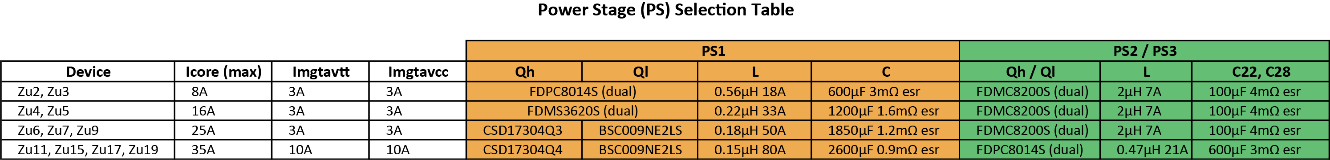
Scalable Zynq US + Always on Solution (UC1)
Notes:
XRP7724 manages sequence and dependency
XRP7724 provides correctly timed Ps_Por_B
PSU Telemetry
Scalable to meet full Zynq US+ Family
Optimized for maximum concatenation of rails
Full Schematic and BOM available
Visit: www.maxlinear.com/xilinx/zynq-ultrascale-plus

Slide 8
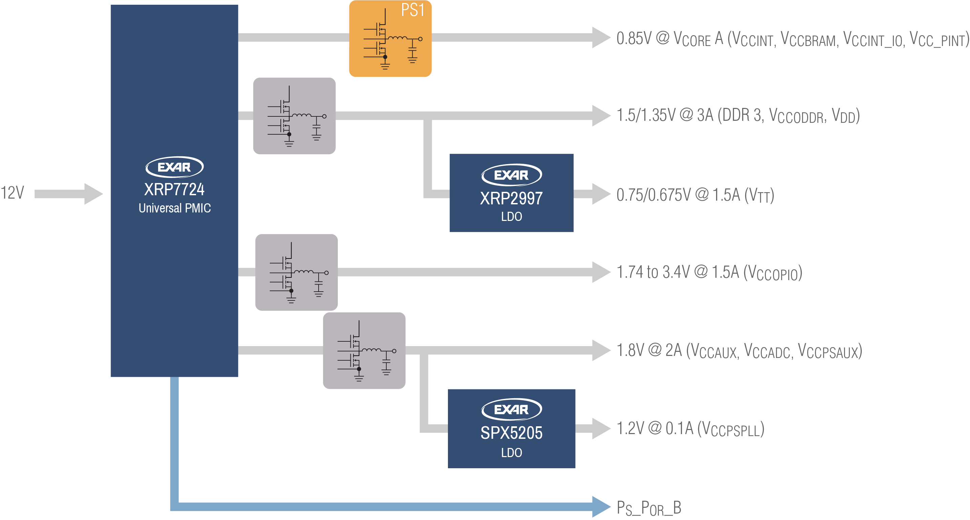
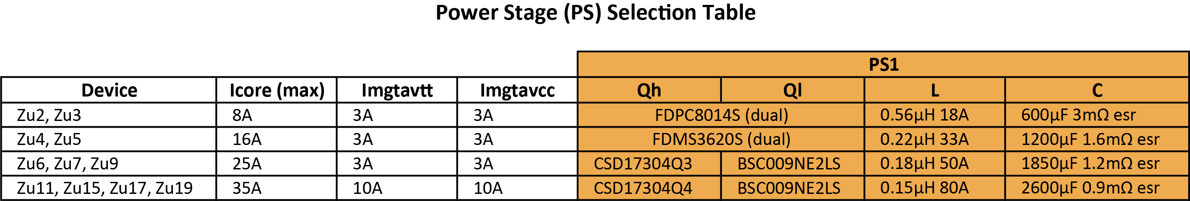
Scalable Zynq US + Always on Solution – No MGTs (UC1)
Notes:
XRP7724 manages sequence and dependency
XRP7724 provides correctly timed Ps_Por_B
PSU Telemetry
Scalable to meet full Zynq US+ Family
Optimized for maximum concatenation of rails
Full Schematic and BOM available
Visit: www.maxlinear.com/xilinx/zynq-ultrascale-plus_nomgts

Slide 9
Challenges & Resolutions
Power Rail Concatenation
  Challenges
    UltraScale+ data sheet specifies >30 power rails for a full system including multi-gigabit transceivers (MGTs)
      For majority of applications this is not required
    Group common rails to obtain a more manageable number and still be compliant with spec
  Resolution
    2 solutions (one with MGTs & one without MGTs)
    Both solutions reduce rails to as few as possible and still meet UltraScale+ spec (UG538)

Slide 10
Challenges & Resolutions continued
Power Rail Sequencing
  Challenges
    Strict power up and power down sequencing requirements
    Power up sequencing requirements different than power down
    Power rail grouping based on V_{OUT} but must also permit sequencing to be realized
  Resolution
    Uses internal digital control to easily manage sequencing requirements
    Programmable sequencing meets UltraScale+ spec for both power up and power down
    Keeps number of separate rails to minimum required to comply with UltraScale+ sequencing requirements

Slide 11
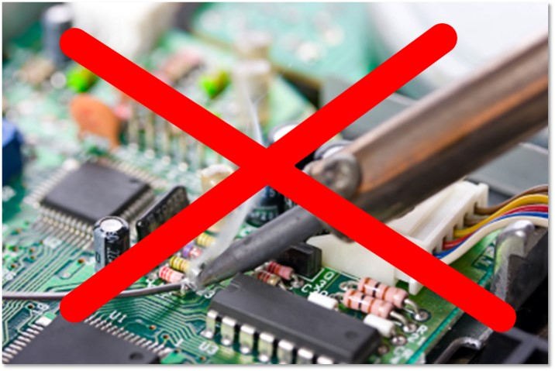
Challenges & Resolutions continued
Core Load
  Challenge
    The core load is difficult to determine with absolute certainty
  Resolution
    Flexible solution allows max current to be adjusted without complete redesign
Performance
  Challenge
    UltraScale+ has tight constraints on V_{OUT} for some rails
    Actual measured results rather than simulation much preferred
  Resolution
    See Slide # 12

Slide 12
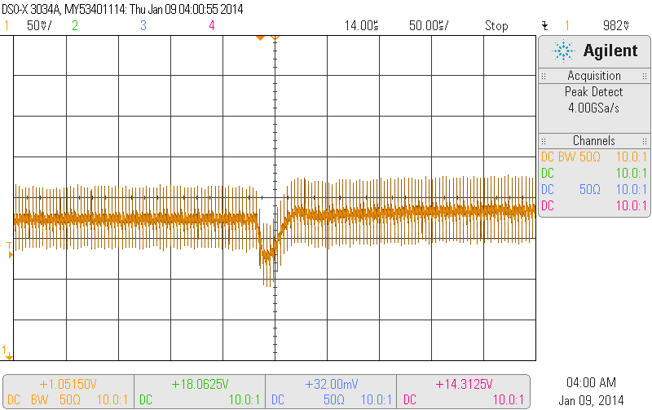
Performance
Actual Measurements
  Simulation does not take into account board parasitics
    When output cap is <1mR plane Z is significant
    Most simulations do not model esl of caps
    Efficiency measured in range of 83-95% depending on Fsw and load
0.9V 5-25A step

Slide 13
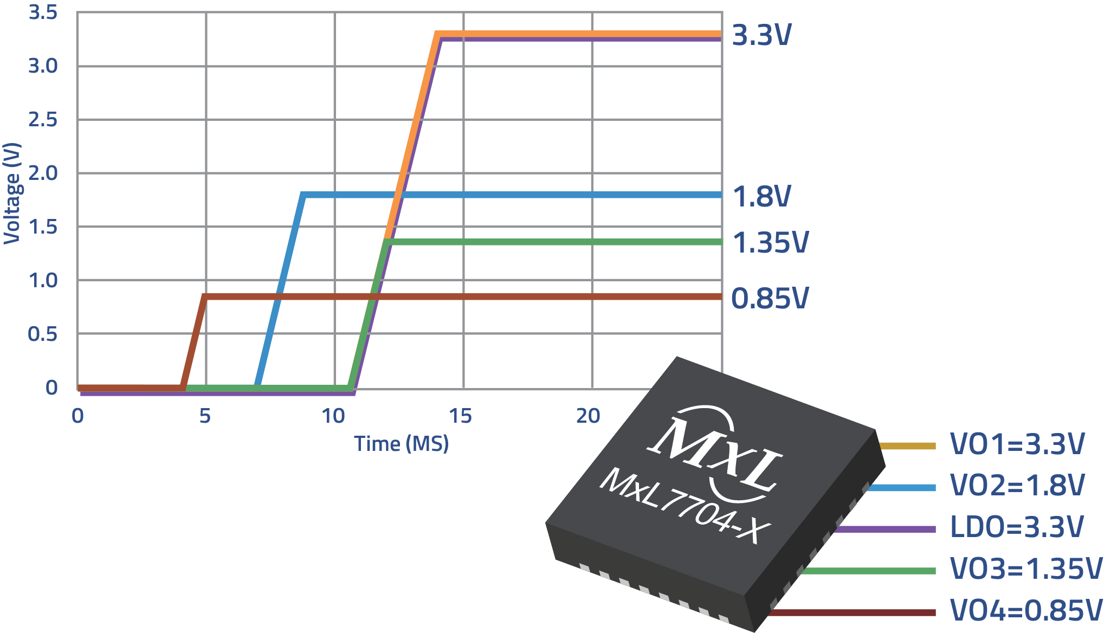
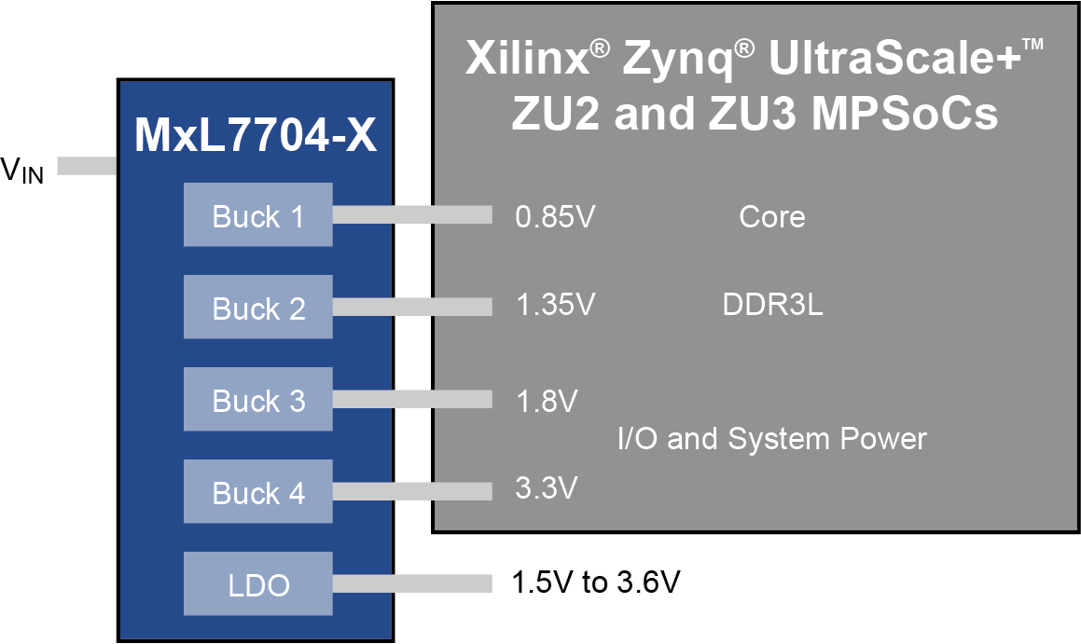
Optimized Power Management IC Provides Highly Efficient Rails for Xilinx Zynq UltraScale+ ZU2 and ZU3 MPSoCs
Pre-Programmed Bucks Provide System, Memory, I/O and Core Power
Sequencing is Tailored to the Unique Needs of the ZU2 and ZU3 MPSoCs

Slide 14
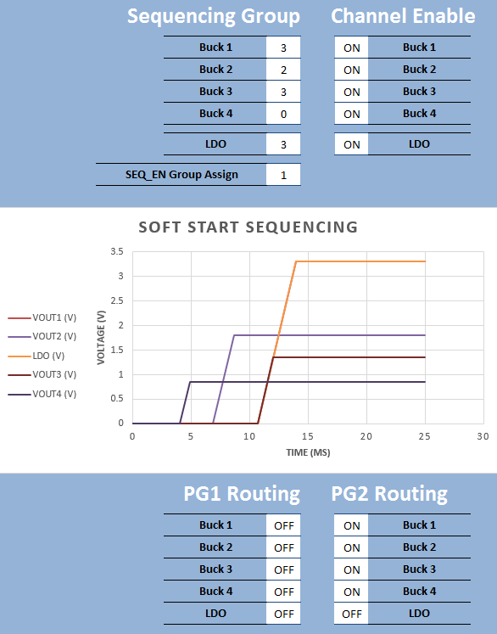
MxL7704-X : Xilinx® Zynq ® Ultrascale+™ ZU2, ZU3
Output Voltages
  3.3V LDO
  3.3V Analog and IO
  1.8V IO
  1.35V DDR3
  0.85V Core
Sequencing
  0.85V → SEQ_EN → 1.8V → 3.3V+1.35V
PGOOD Assigned
  PGOOD1 – unused
  PGOOD2 – logical AND of all bucks
1.0MHz switching frequency
Chip Fault
78ohm and soft off on
SEQ_EN
3.3V
1.8V
1.35V
0.85V

Slide 15
Appendix

Slide 16
Universal PMIC Selector Guide
 | MxL7704 | XR77103 | XRP7740 | XRP7713 | XRP7714 | XRP7724 | XRP7725 | XR77128 | XR77129
Channels | 4 | 3 | 4 | 3 | 4 | 4
Input Voltage | 4.5-5.5 | 4.5-14 | 6.5V-20V | 4.75V-25V |  | 4.75V-25V |  |  | 6V – 40V
Output Voltage | 3.0; 1.3; 0.8; 0.6 | 0.8-6 | 0.9V-5.1V |  |  | 0.6V-5.5V 2% -40°C→125°C |  | 0.6V-5.5V* 1.25% -40°C→125°C
Gate Drive Ω | 1.5A; 1.5A; 2.5A; 4A | Integrated MOSFETS | 3Ω/1.8Ω | 6Ω/3Ω |  | 4Ω/2Ω
Vo Resolution | 20mv; 20mV; 6.25mV; 6.25mV | 50mV | 50mV / 100mV |  |  | 2.5mV/5mV/10mV
Frequency (MHz) | 1 to 2.1 | 0.3 to 2.2 |  | Up to 1.5 |  | Up to 1.2
Monitoring Res | 8bit | N/A | 8bit | 7bit |  | 7bit | 7bit+ | 7bit
IQuiescent | 8 | 1.5mA | 9mA |  |  | 4mA
Controller/Regulator | Regulator |  | Controller
Control Scheme | Current Mode PWM | Analog current mode | DPWM (11bit fixed, 0.5T Conversion) 300kHz-1.5MHz |  |  | DPFM/DPWM (17bit, 607ps fixed, 200ns conversion) 106kHz-1.2MHz – 1x; 2x; 4x Selectable
Phasing |  | Selectable 0°/180° | Selectable 90°/120° | Fixed 90° |  | Variable with 22.5° resolution
Comm. | I²C | I²C | I²C | I²C with PEC |  | SMBus/I²C
GPIOs | N/A | PGOOD | 4+2 |  |  | 2+3 PSIO |  | 2+3 PSIO w/add’l options
LDOs | 100mA | N/A | Single 3.3V or 5V – 110mA |  |  | Dual 3.3V & 5V / 110mA
Memory Type | Factory Only | Flash | OTP |  |  | Flash
Light Load |  | ✓ | ✓ | ✗ |  | ✓
Package | 5x5 QFN32 | 4x4 TQFN32 | 6x6 TQFN40 | 5x5 TQFN32 | 6x6 TQFN40 | 7x7 TQFN44 pin compatible family
Other | 2 configurable PGOOD outputs; LDO & 2-Input 8-bit ADC, Temp Monitoring MxL7704-A (Sequencing I/O first core last), MxL7704-X (Sequencing for Xilinx® Zynq® Ultrascale+™ ZU2 and ZU3) | Lower Cost | High Current | Best Value |  |  | Intel Node Manager Compatible | DrMOS Output | Higher outputs w/ ext. resistors

Slide 17
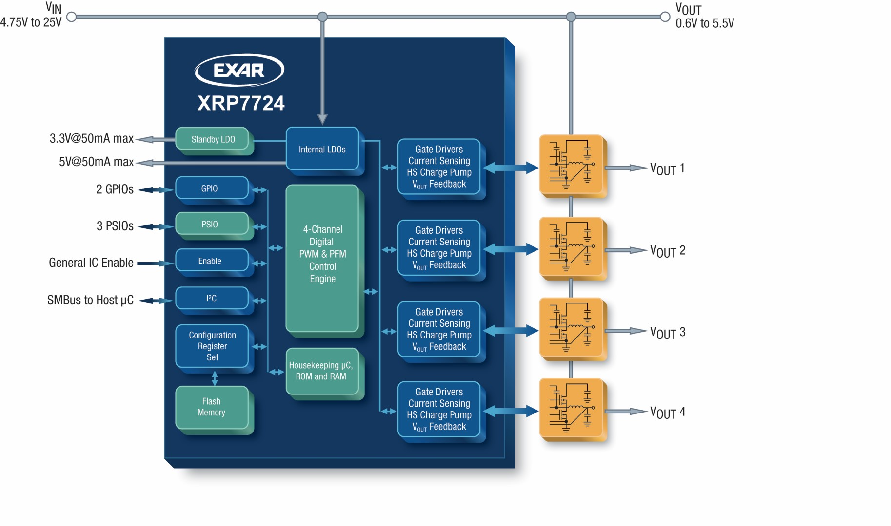
XRP7724 Functional Block Diagram

Slide 18
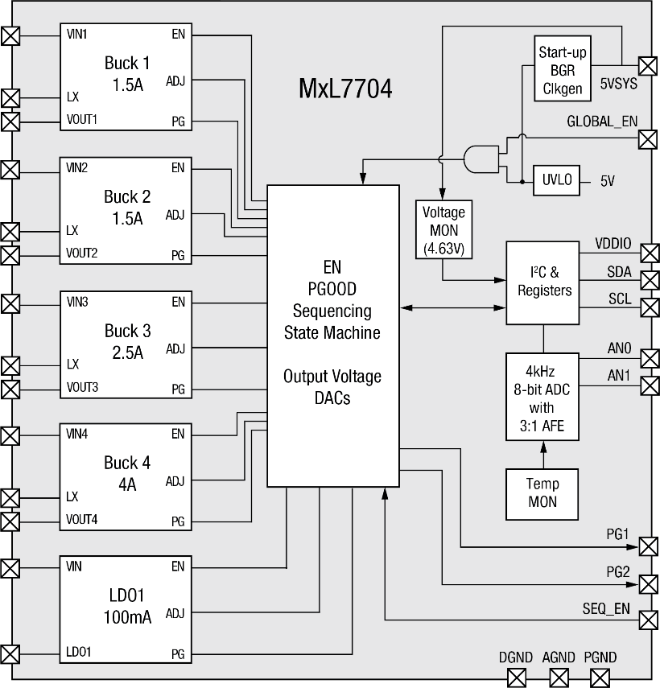
MxL7704
Universal PMIC with 4 Buck Regulators, one LDO, and 2 input 8bit ADC
Key Features
4.0V to 5.5V input supply voltage range Monolithic synchronous MOSFETs Current-mode control internally compensated 4A/2.5A/1.5A/1.5A Buck Regulator Outputs 100mA LDO I²C provides dynamic control Dynamic voltage control on all outputs 2 Configurable Power Good Output Conditional Power up and down sequencing with external input for chip to chip sequencing Switching frequency (1MHz to 2.1MHz) Supported by Excel configuration tool 8 Bit ADC read through I2C 2 external inputs with 2.55V range,10mV resolution Temperature monitoring -40°C to 150°C 32-pin TQFN package, 5mm x 5mm
Functional Block Diagram
Benefits
Programmable Power Technology Capable of supporting a wide range of processors Fast TTM Dynamic control Easy system integration High level integration
Key Competitive Advantages
I²C interface tailor to processor requirements Flexible Sequencing ADC provides telemetry flexibility
Availability & Tools
Production MxL7704-A ARM® Cortex® A53 and A7/9 MxL7704-X Xilinx® Zynq® Ultrascale+™ ZU2/3 Excel configuration tool Evaluation Boards
Applications
Low power FPGAs such as Xilinx® Zynq® Ultrascale+™ ARM based processors | Embedded low power processors Industrial control POS terminals

Slide 19
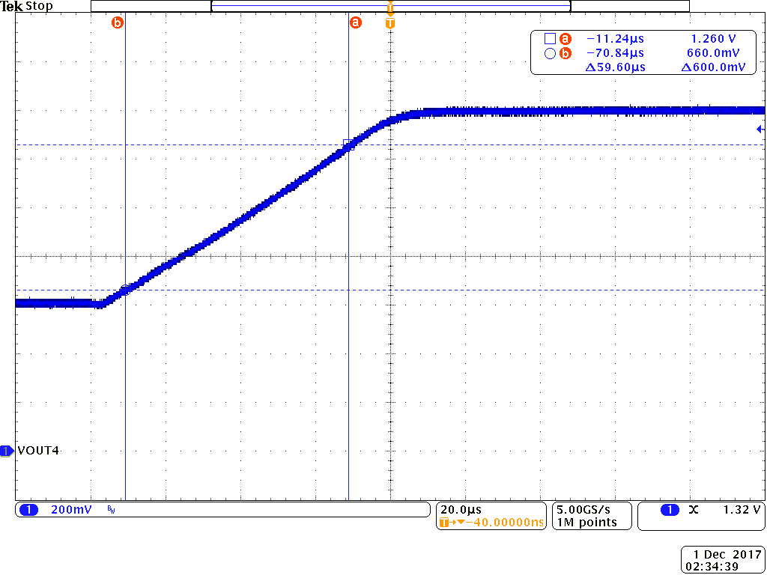
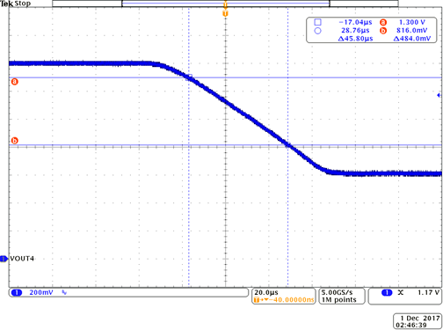
Dynamically Controllable Outputs
Buck 1 1.5A 3.0V to 3.6V 20mV resolution
Buck 2 1.5A 1.3V to 1.92V 20mV resolution
Buck 3 2.5A 0.8V to 1.6V 6.25mV resolution
Buck 4 4.0A 0.6V to 1.4V 6.25mV resolution
LDO 0.1A 1.5V to 3.6V 20mV resolution
DVS (Dynamic Voltage Scaling) at 10V/ms slew rate meets the latency demands of most processors.
10V/ms
10V/ms

Slide 20
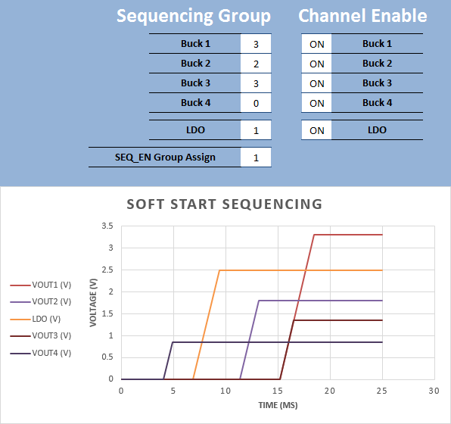
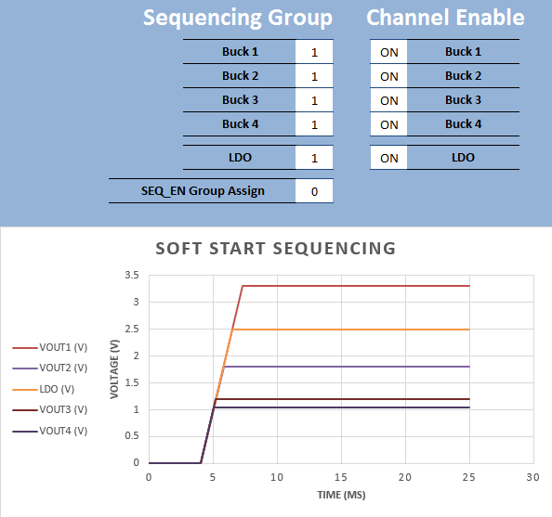
Flexible Conditional Sequencing Engine
4 Sequencing Groups 0 → 3
All outputs may be assigned to any sequencing group
Sequencing of the next group is conditional on PGOOD of the first with a 2ms delay
SEQ_EN input pin gates the sequencing at the group it is assigned.
Down sequencing is the reverse order of power up.
SEQ_EN
SEQ_EN
2ms delay

Slide 21
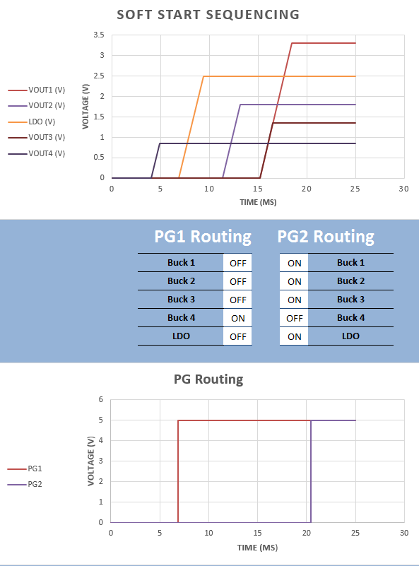
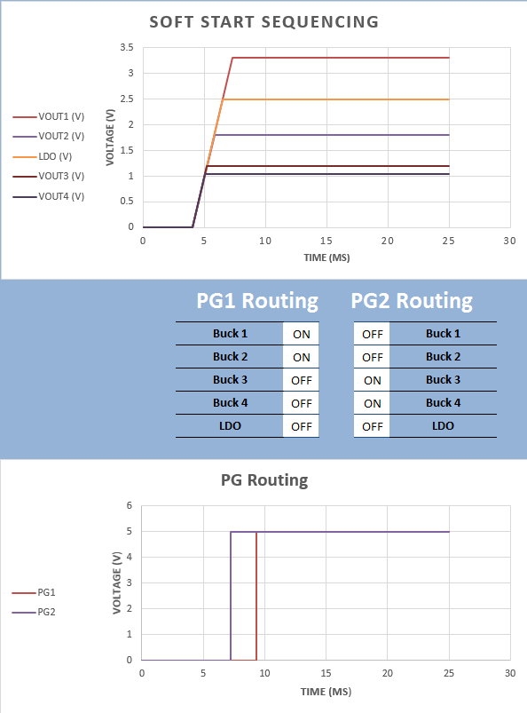
PGOOD Routing Flexibility
2ms delay
PGOOD Outputs are a logical AND of all the channels assigned to it
Any channel may be assigned to any PGOOD
PGOOD goes high when the output is >90% of the final value and soft-start is complete with a 2ms delay
PGOOD de-asserts when <85% of target or when channel is shut down

Slide 22
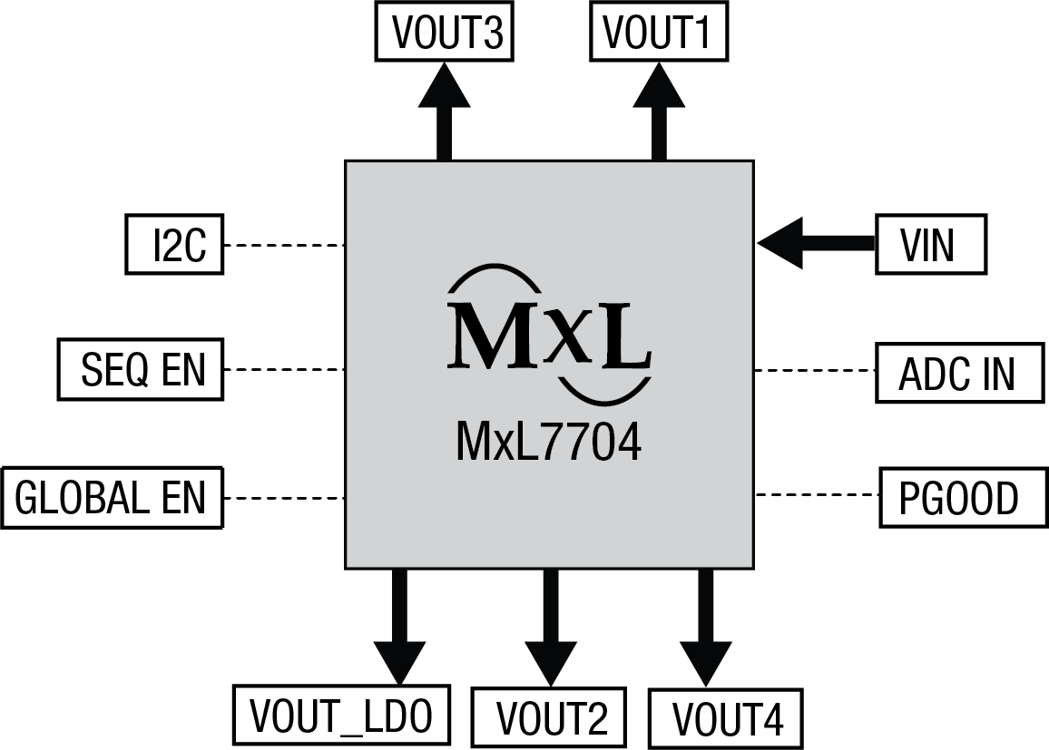
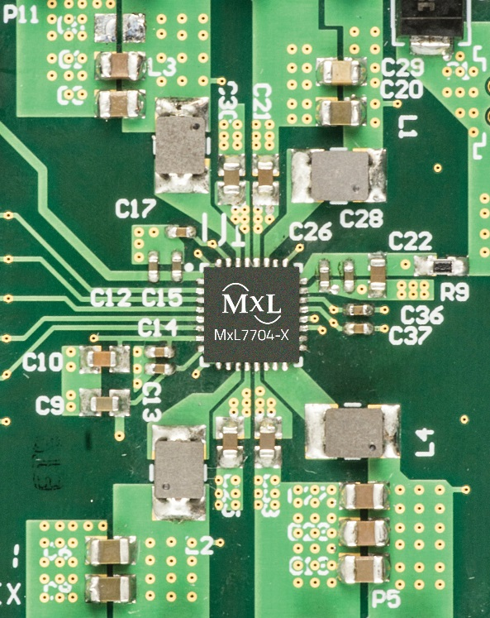
MxL7704 Evaluation Board Block Diagram
Top View MxL7704 EVB
Board layout maintains flexibility for the engineer to easily modify components to exercise MxL7704 capabilities

Slide 23
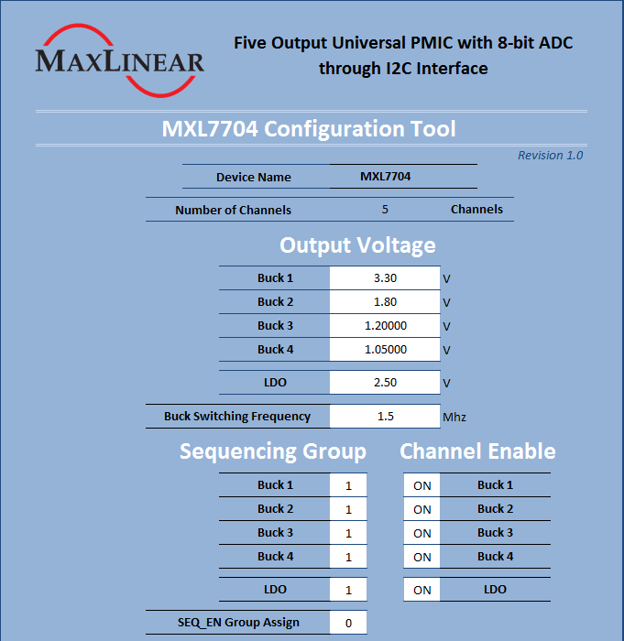

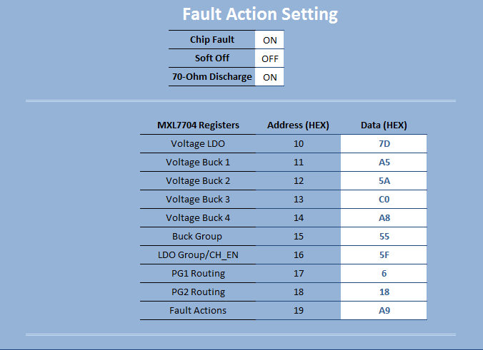
Software Support
Simple tool providing the customer a fast and easy way to generate register bits to meet their system requirement
Address | Register | R/W | Bit 7 | Bit 6 |  | Bit 5 | Bit 4 | Bit 3 | Bit 2 | Bit 1 | Bit 0
0x10 | Vout LDO1 | R/W | VLDO1[7:0]
0x11 | Vout Buck1 | R/W | VBuck1[7:0]
0x12 | Vout Buck2 | R/W | VBuck2[7:0]
0x13 | Vout Buck3 | R/W | VBuck3[7:0]
0x14 | Vout Buck4 | R/W | VBuck4[7:0]
0x15 | Buck Sequence Group Assignment | R/W | Buck 4[1:0] |  | Buck 3[1:0] |  |  | Buck 2[1:0] |  | Buck 1[1:0]
0x16 | LDO1 Sequence Group Assignment and Channel Enables | R/W | LDO1[1:0] |  |  |  | EN4 | EN3 | EN2 | EN1 | ENL
0x17 | SEQ_EN Assign and PG1 Routing | R/W | EN Assign |  |  |  | Buck4 | Buck3 | Buck2 | Buck1 | LDO
0x18 | PG2 Routing | R/W |  |  |  |  | Buck4 | Buck3 | Buck2 | Buck1 | LDO
0x19 | Fault Actions, Down Sequencing, Frequency | R/W | Chip/ Channel | Soft Off | 78ohm discharge |  |  | FREQ[3:0]*

Slide 24

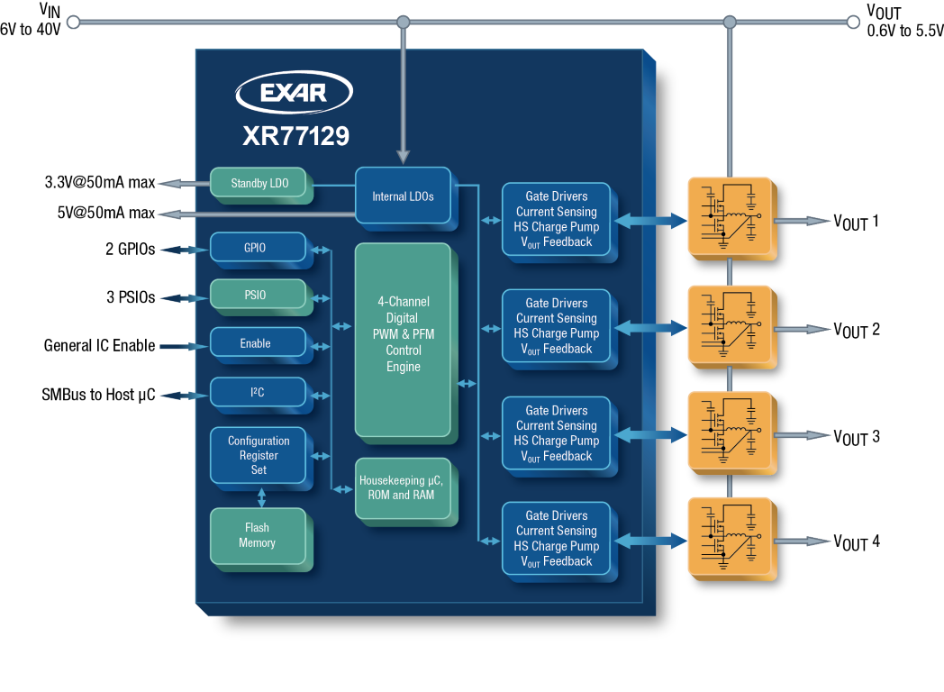
XR77129
40V Quad Output Digital PWM/PFM Universal PMIC
Key Features
Quad Channel Step-down Controller Digital PWM 105kHz-1.23MHz operation Individual channel frequency selection Patented digital PFM with ultrasonic mode Integrated MOSFET drivers 6V to 40V Input Voltage 0.6V to 5.5V output voltage (higher w/external resistors) SMBus Compliant I2C Interface Full Power Monitoring and Reporting 3 x 15V Capable PSIO + 2 x GPIOs Full Start/Stop Sequencing Support Built-in thermal, over-current, UVLO & output Over-voltage protection On-board 5V and LDOOUT Standby LDOs On-board non-volatile memory
Key Competitive Advantages
Lower power/channel <1.5mA vs industry at 30mA State machine based Lower cost and component count Saves as many as 50 components Easy to use Easy to use tools Intuitive register map
Benefits
Only 40V digital controller Flexible, adaptive & economical Quickly adaptable design Reduced time to market Integrates several functions/ICs Reliable Eliminates passive components temperature drifts and aging Remote monitoring/configuration High Performance Optimized power conversion / output
MaxLinear PMIC Advantages
Functional Block Diagram
Availability & Tools
In Production XR77129 TQFN44 Supported by PowerArchitect™ 5.2 or later Evaluation Board Demo Kit with PowerArchitect Full line of Universal PMICS XRP7704-40, XRP7713-14, XRP7724, XRP7725 & XR77129, XR77103
Applications
Industrial Equipment Test Equipment | Automotive Base Stations

Slide 25
Thank You

